Slide 1
Query Performance
Execution Plan, Live Statistics
Index Choices
Query Analyzer Tuning Advisor (not supported in Express)

Slide 2
Explanation how to read execution plan
https://www.sqlshack.com/sql-server-query-execution-plans-understanding-reading-plans/

Slide 3
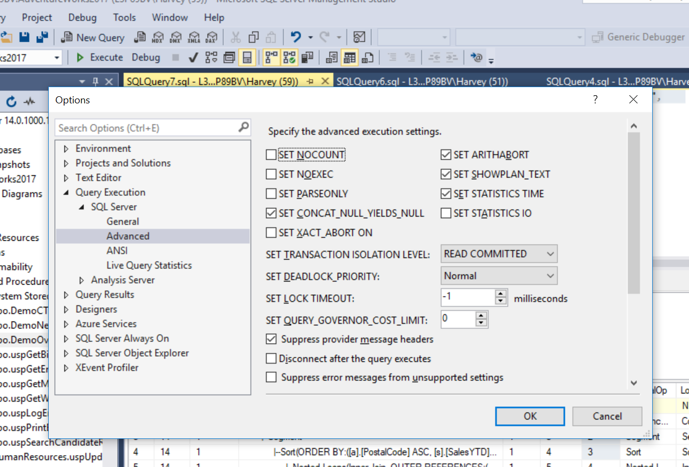
Setting Options

Slide 4
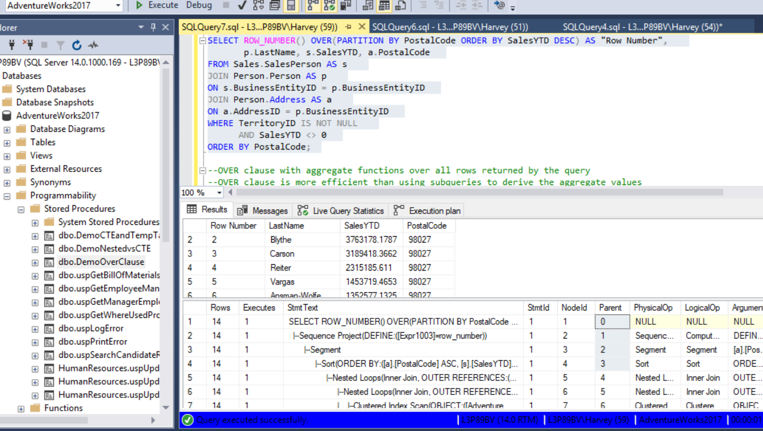

Slide 5
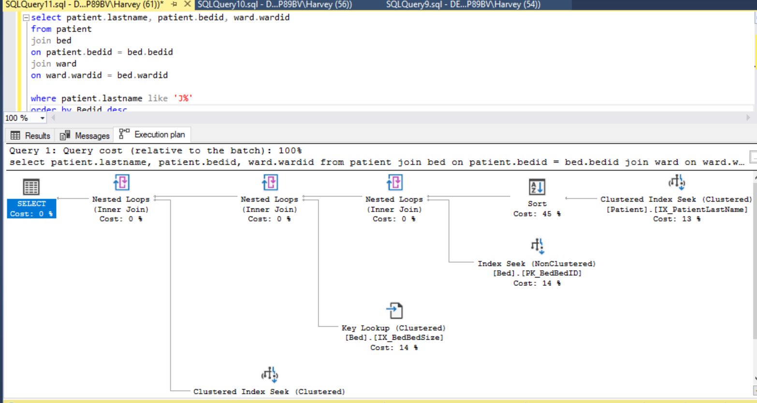
Which columns should we include in our index?
Cluster or non-cluster?

Slide 6
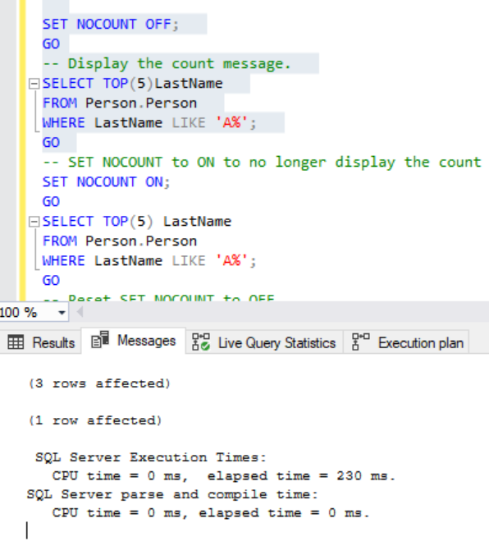
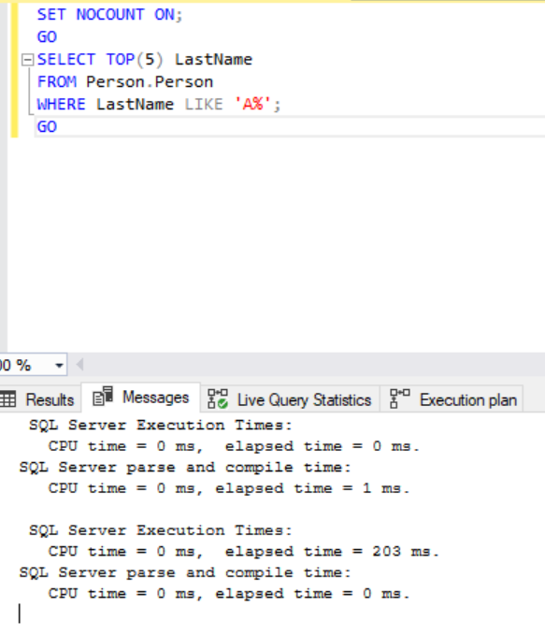
https://docs.microsoft.com/en-us/sql/t-sql/statements/set-nocount-transact-sql?view=sql-server-2017

